Slide 1
Developing the Serpentine & Murray River Action Plans
16 June 2022
Jesse Rowley, Healthy Waterways Officer

Slide 2
What is a River Action Plan and why are we doing this?
There are no simple quick fix solutions to the issues faced by our rivers
A River Action Plan presents an informed and integrated approach to protecting the environmental health of our rivers
River Action Plans are documents that provide vital information on the current state of the river and guidance on future restoration actions
To be utilised by wider community

Slide 3
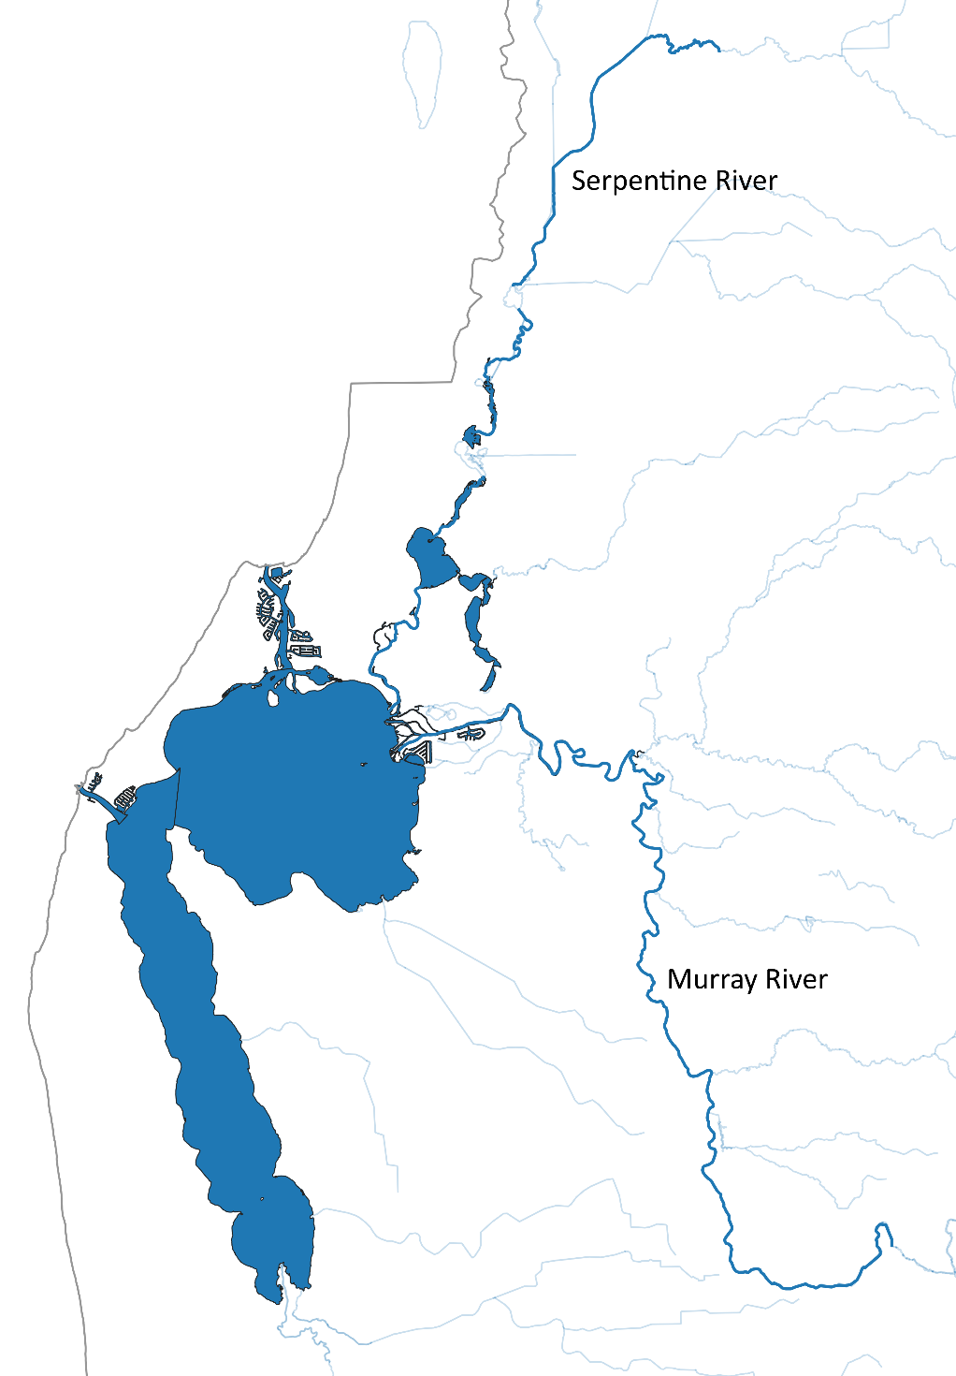
Connecting Corridors and Communities & Healing Bilya
Combined total of $1.35 million US through the Alcoa Foundation’s Three Rivers One Estuary Initiative
Connecting Corridors and Communities Restoring the Serpentine River:
$750,000 US over 3 years (2018 – 2020)
Objective: Improving the health, biodiversity and ecosystem services of the Serpentine River and the adjacent riparian zones and ultimately our Ramsar482 site.
Healing Bilya-Restoring the Murray and Serpentine Rivers:
$600,000 US over 3 years (2020 – 2023)
Objective: Improving the health, biodiversity and ecosystem services of the Murray and Serpentine Rivers and the adjacent riparian zones, and ultimately our Ramsar482 site.

Slide 4
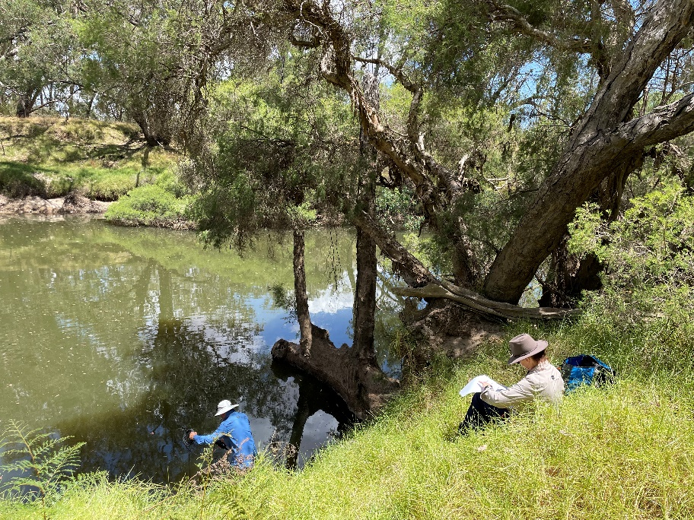
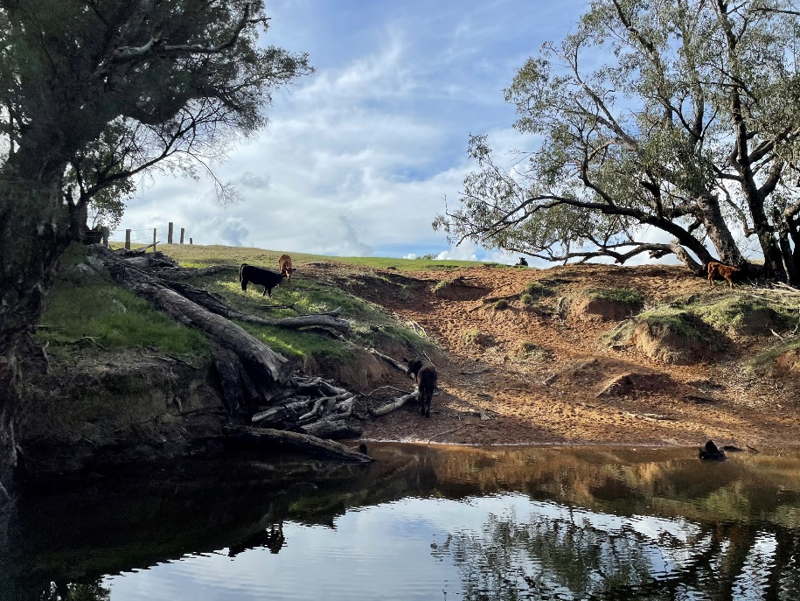
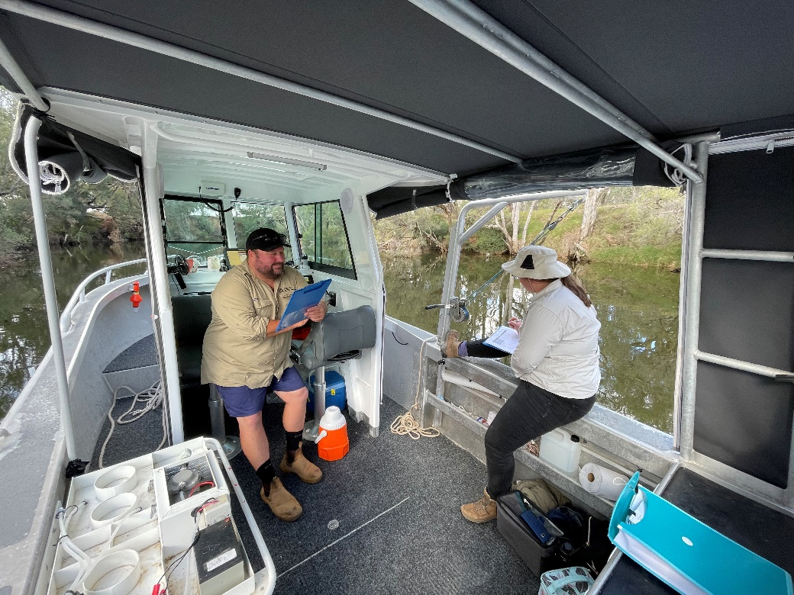
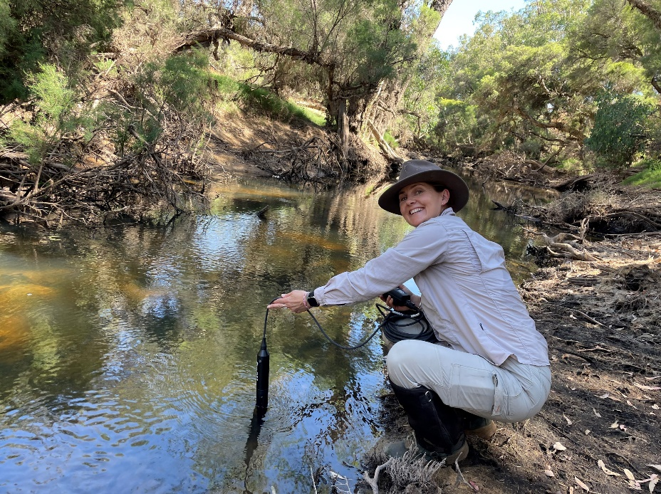
River Action Plan Methodology
Step-by-step process – Partnership Project
Literature Review
Desktop analysis
Field Work (vegetation, geormorphology, aquatic habitat, Water Quality)
Mapping
Individual Reach Assessment (foreshore condition scoring)
Consultations

Slide 5
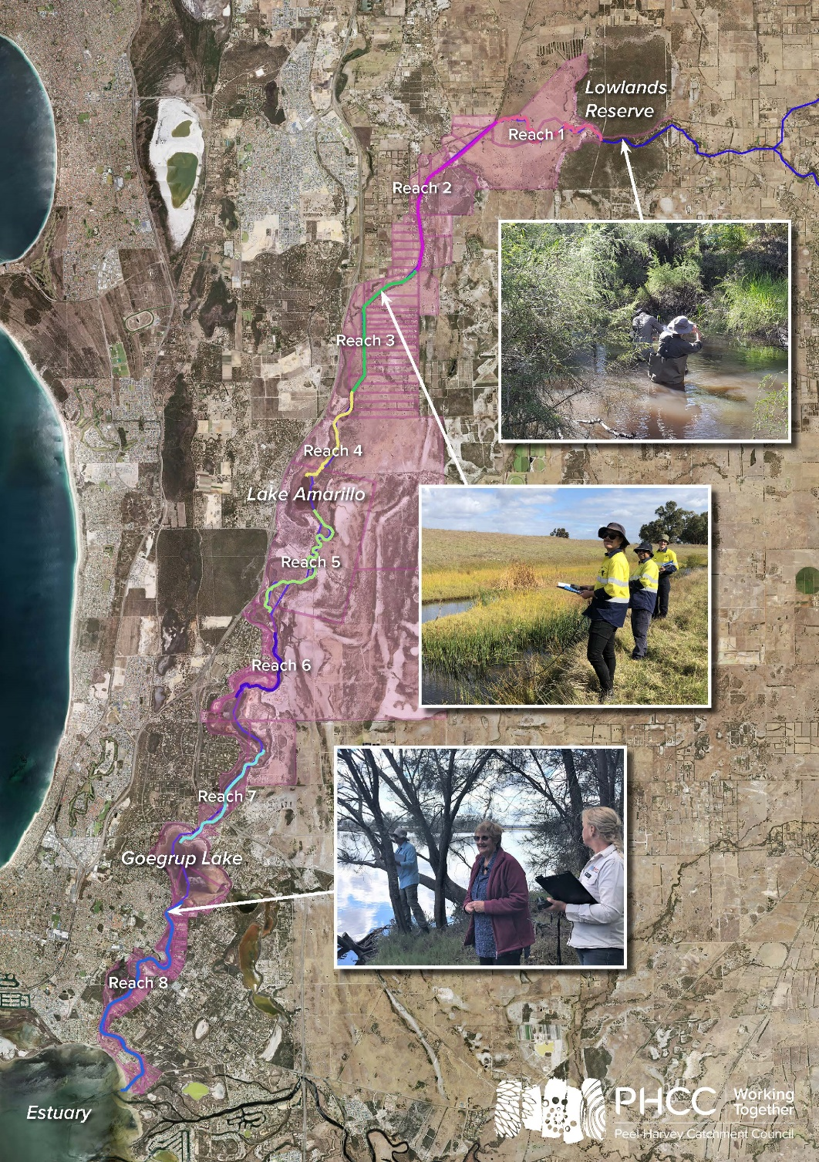
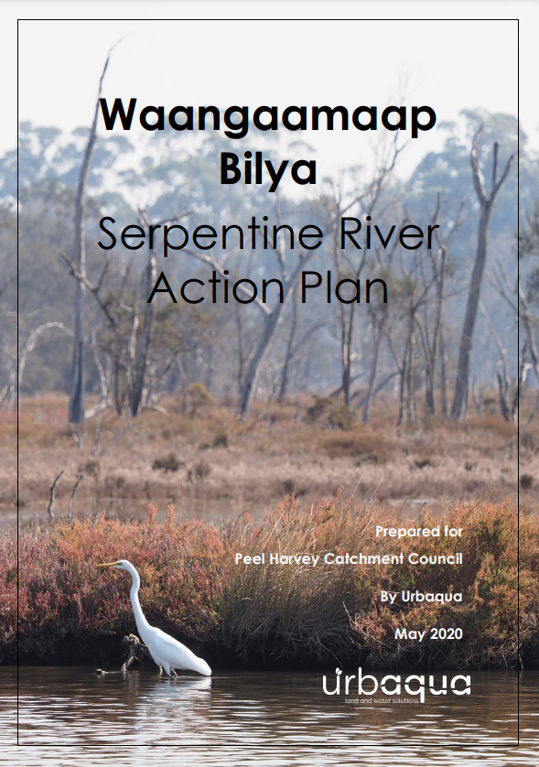
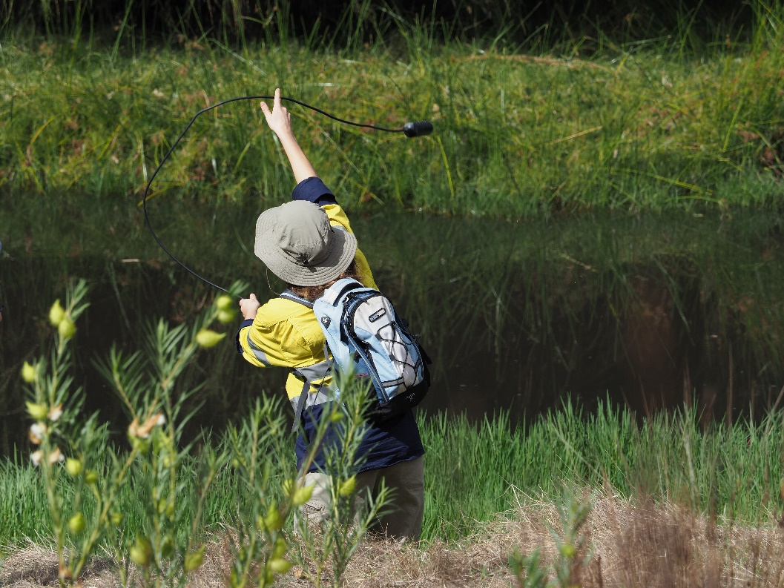
Waangaamaap Bilya – Serpentine River Action Plan
Partnership Project with Urbaqua
38 km of river surveyed by foot
Priority areas mapped
Example: Reach 4 – Feral Pig Control through ‘Healing Bilya’
Undertaken through Healing Bilya project
37 pigs removed (Oct 21 – Mar 22: 440 PHCC & DBCA funding)

Slide 6
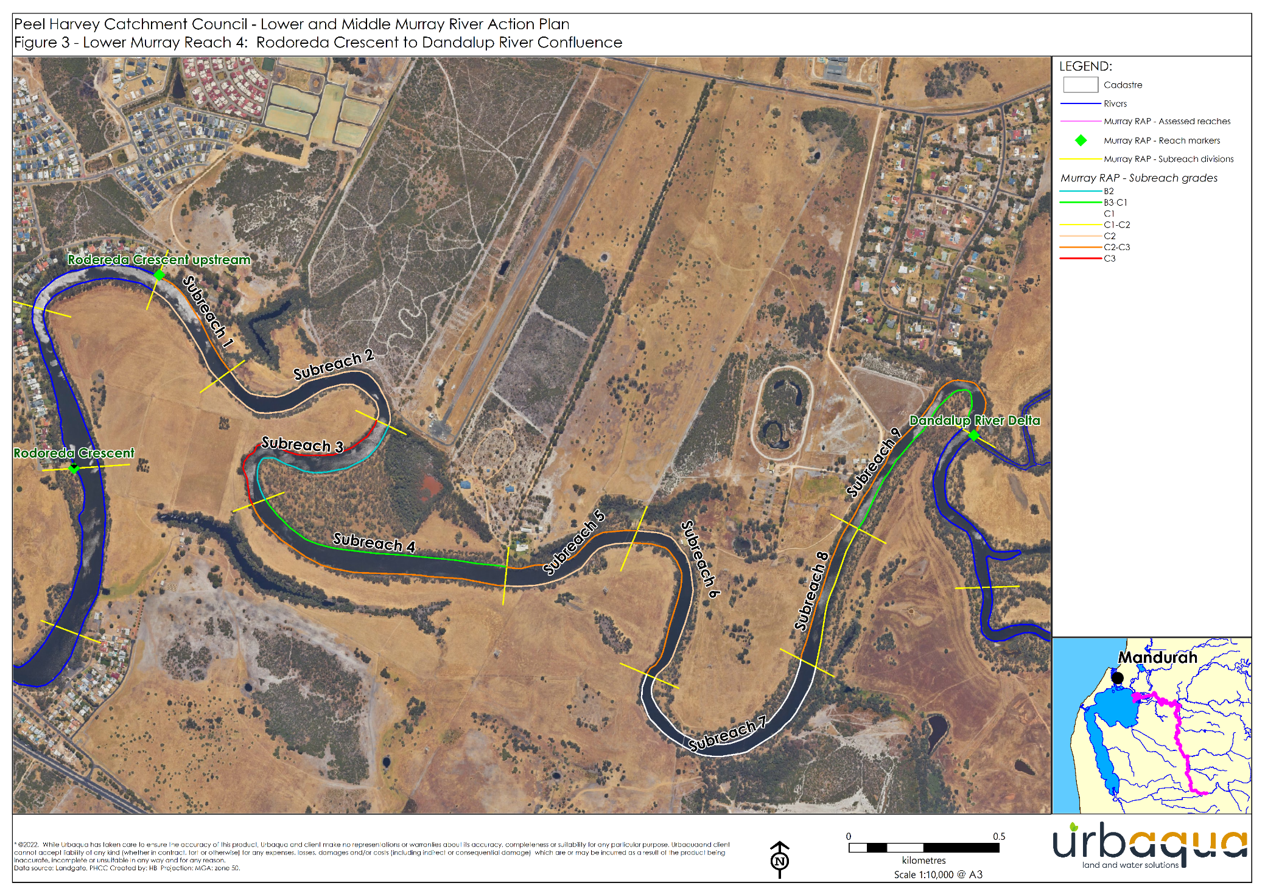
Lower & Middle Murray River Action Plans
Partnership Project with Urbaqua
In progress
Desktop Analysis & Fieldwork completed
Data analysis underway
Main conclusions so far:
Erosion mainly caused by continuous livestock access to the river
High weed loads across Middle Murray
Cottonbush
DRAFT

Slide 7
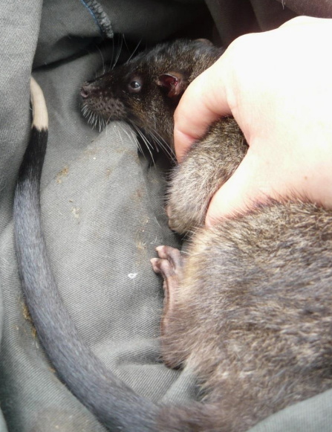
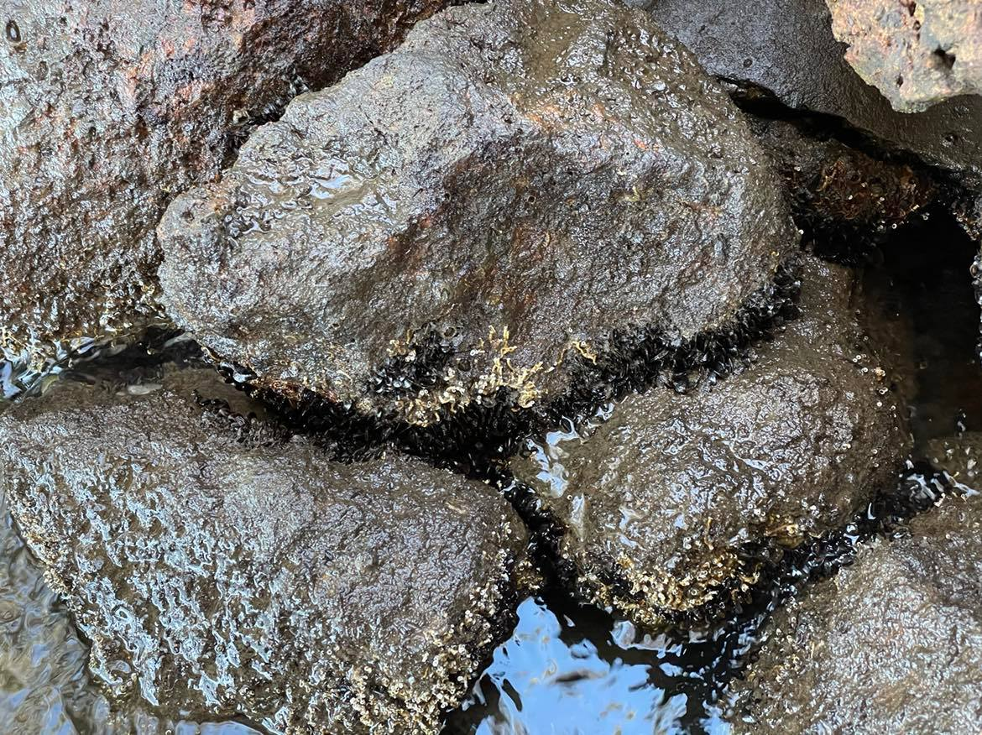
Rakali (Native Water Rat)
Image: Dr Karen Bettink
Population in decline due to degradation of habitat
Priority 4 species (Rare, Near Threatened)
Indicators of waterway health
A great species to use to engage with community
Recent sightings on Murray and Serpentine Rivers
Black Pygmy Mussel colonisation providing additional food sources and potentially improving Rakali abundance

Slide 8
Rakalis on the Murray…
Footage courtesy of Geoff Crosse

Slide 9
And Serpentine….
Footage courtesy of DBCA

Slide 10
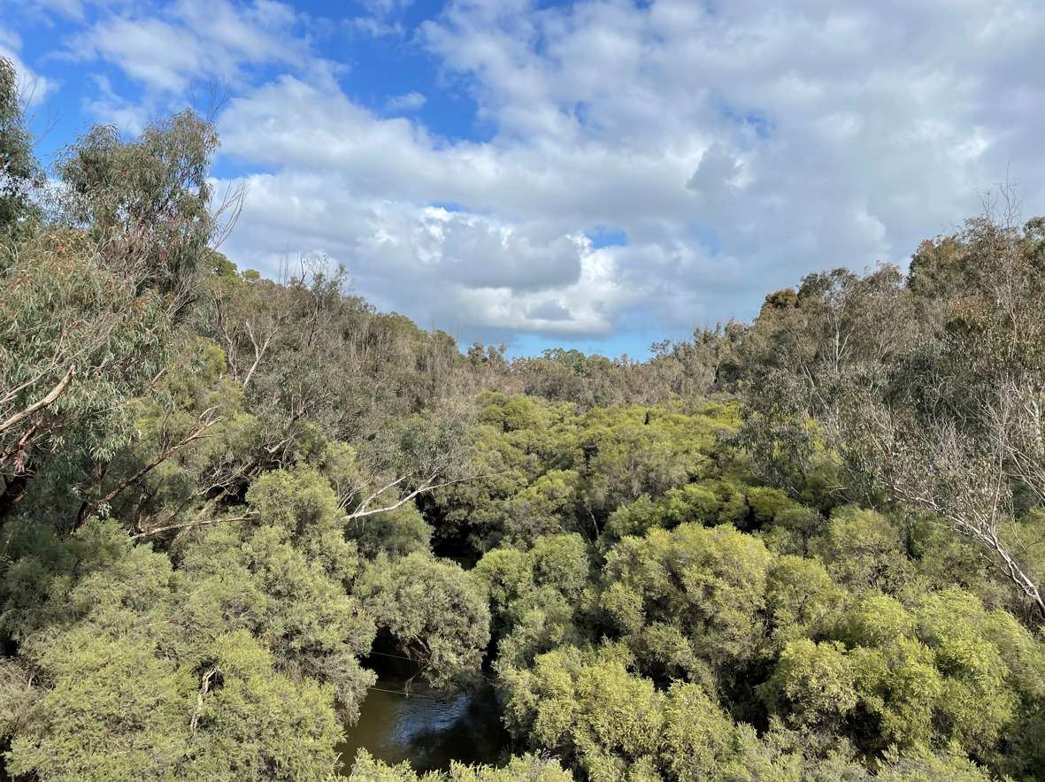
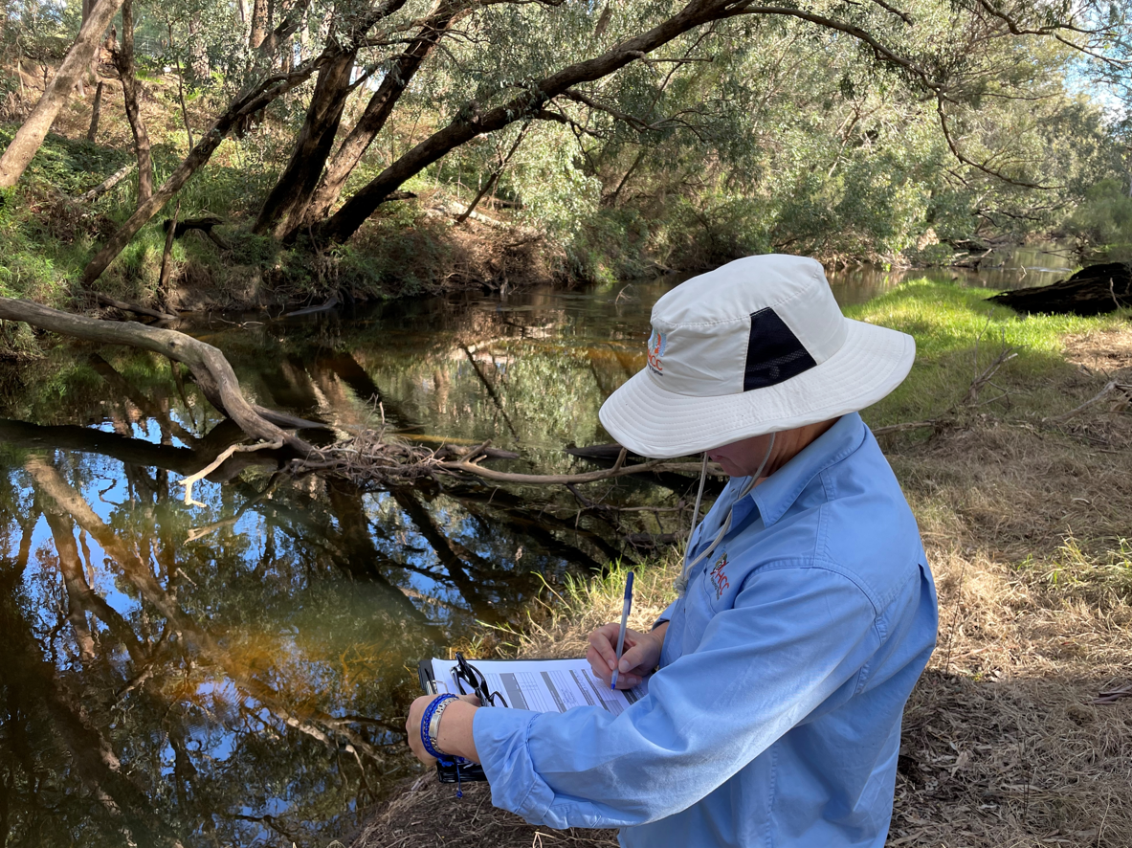
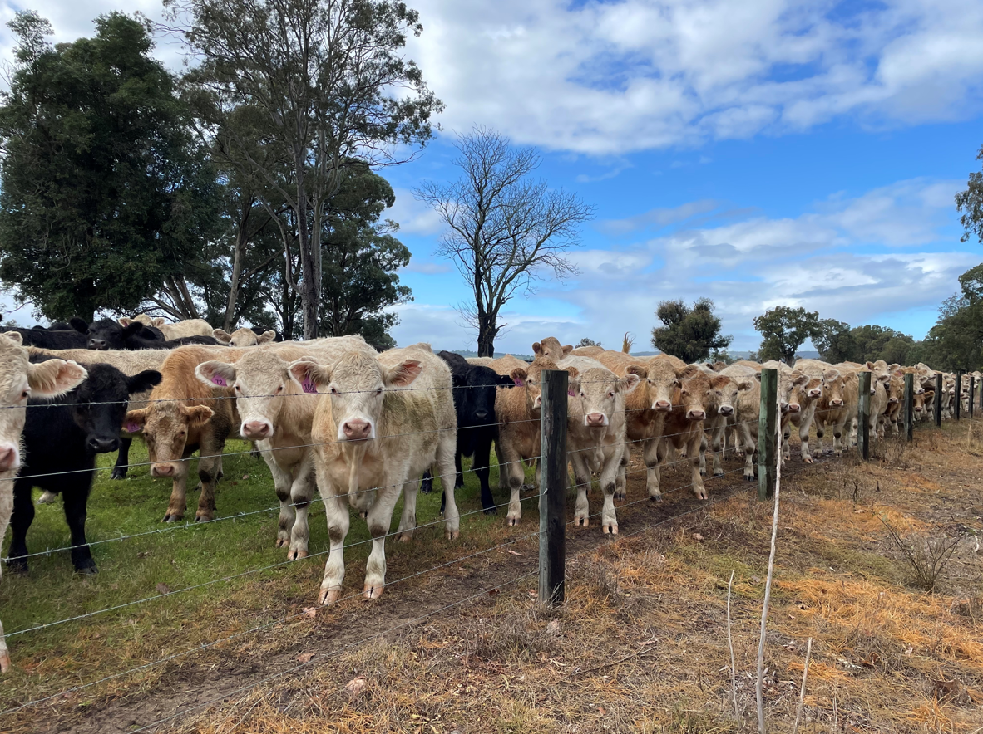
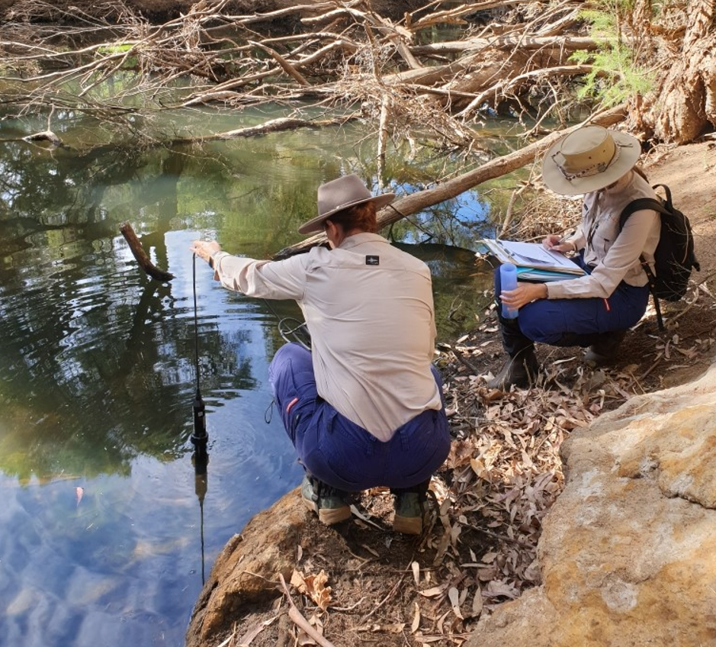
Take Home Messages & Thank You’s
River Action Plans are the first step in the process to improve our Serpentine & Murray Rivers
These are documents to be used by all organisations and the wider community
PHCC are implementing priority actions outlined in the Serpentine River Action Plan
Rakali’s are awesome and we need to find more ways to protect them into the future
Thank you to PHCC, Urbaqua and other volunteers and staff for helping develop the River Action Plans!
Thank you Dept. of Water and Environmental Regulation – Michael Kenrick

Slide 11
Thank you for your time today!
Follow us:
@PeelHarveyCatchmentCouncil
@PeelHarveyCC @JesseRowleyPHCC
Search our hashtags to find our latest posts!
#SaveOurSerpy
#HealingBilya
#PeopleWorkingTogether
#ConnectingCorridorsandCommunities

